Slide 1
Reminders...
You’ll use this file for the entirety of this capstone. Save it in a place where you can easily access it over the upcoming weeks.
You can edit and save this document in Google Drive
If you download this document, keep it in a place you can find it later
The content you put into this document will be used later
It is recommended that you do not skip any capstone readings
Feel free to customize this slide deck to make it your own, but make sure to answer all the questions in the prompts
Requirements:
Answer all the questions in this document
When complete, download this as a PDF document for submission in the peer review assignment.
Don’t know how to download as a PDF? You can find more information about downloading this by clicking here.
Remove this slide before submitting

Slide 2
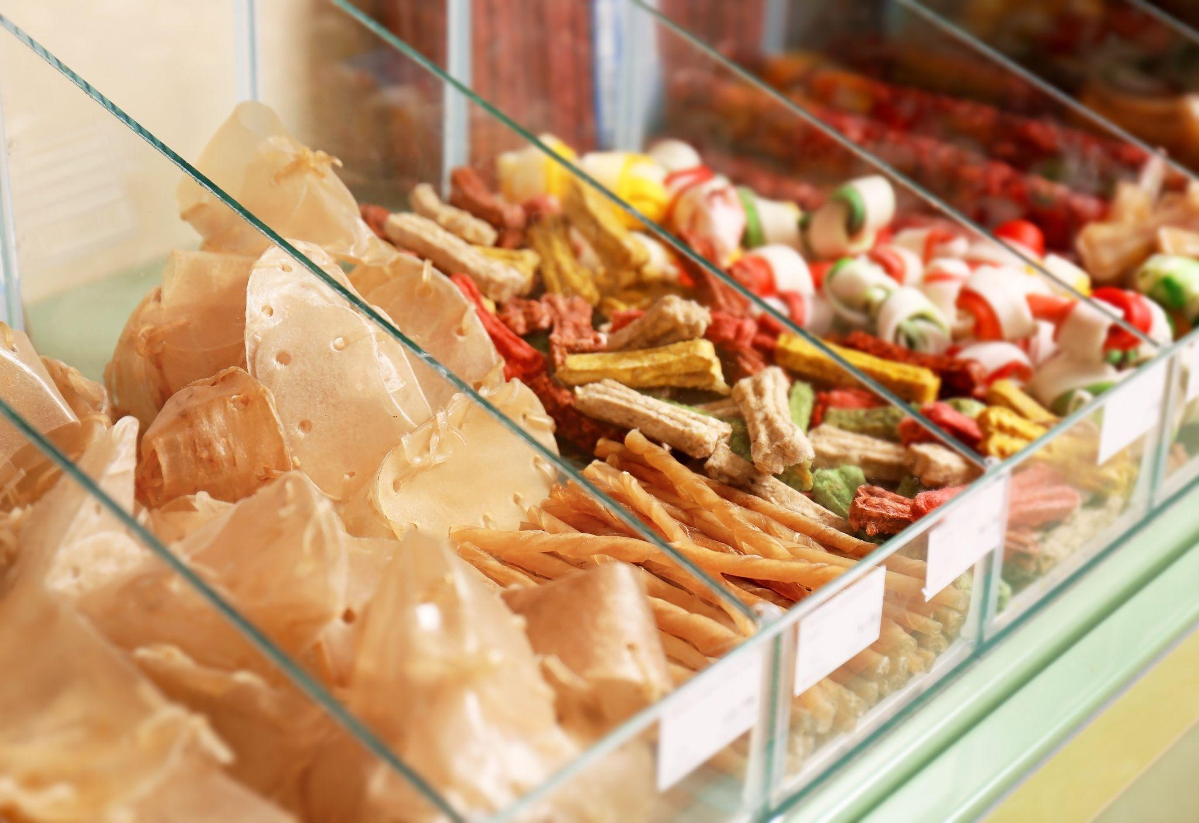

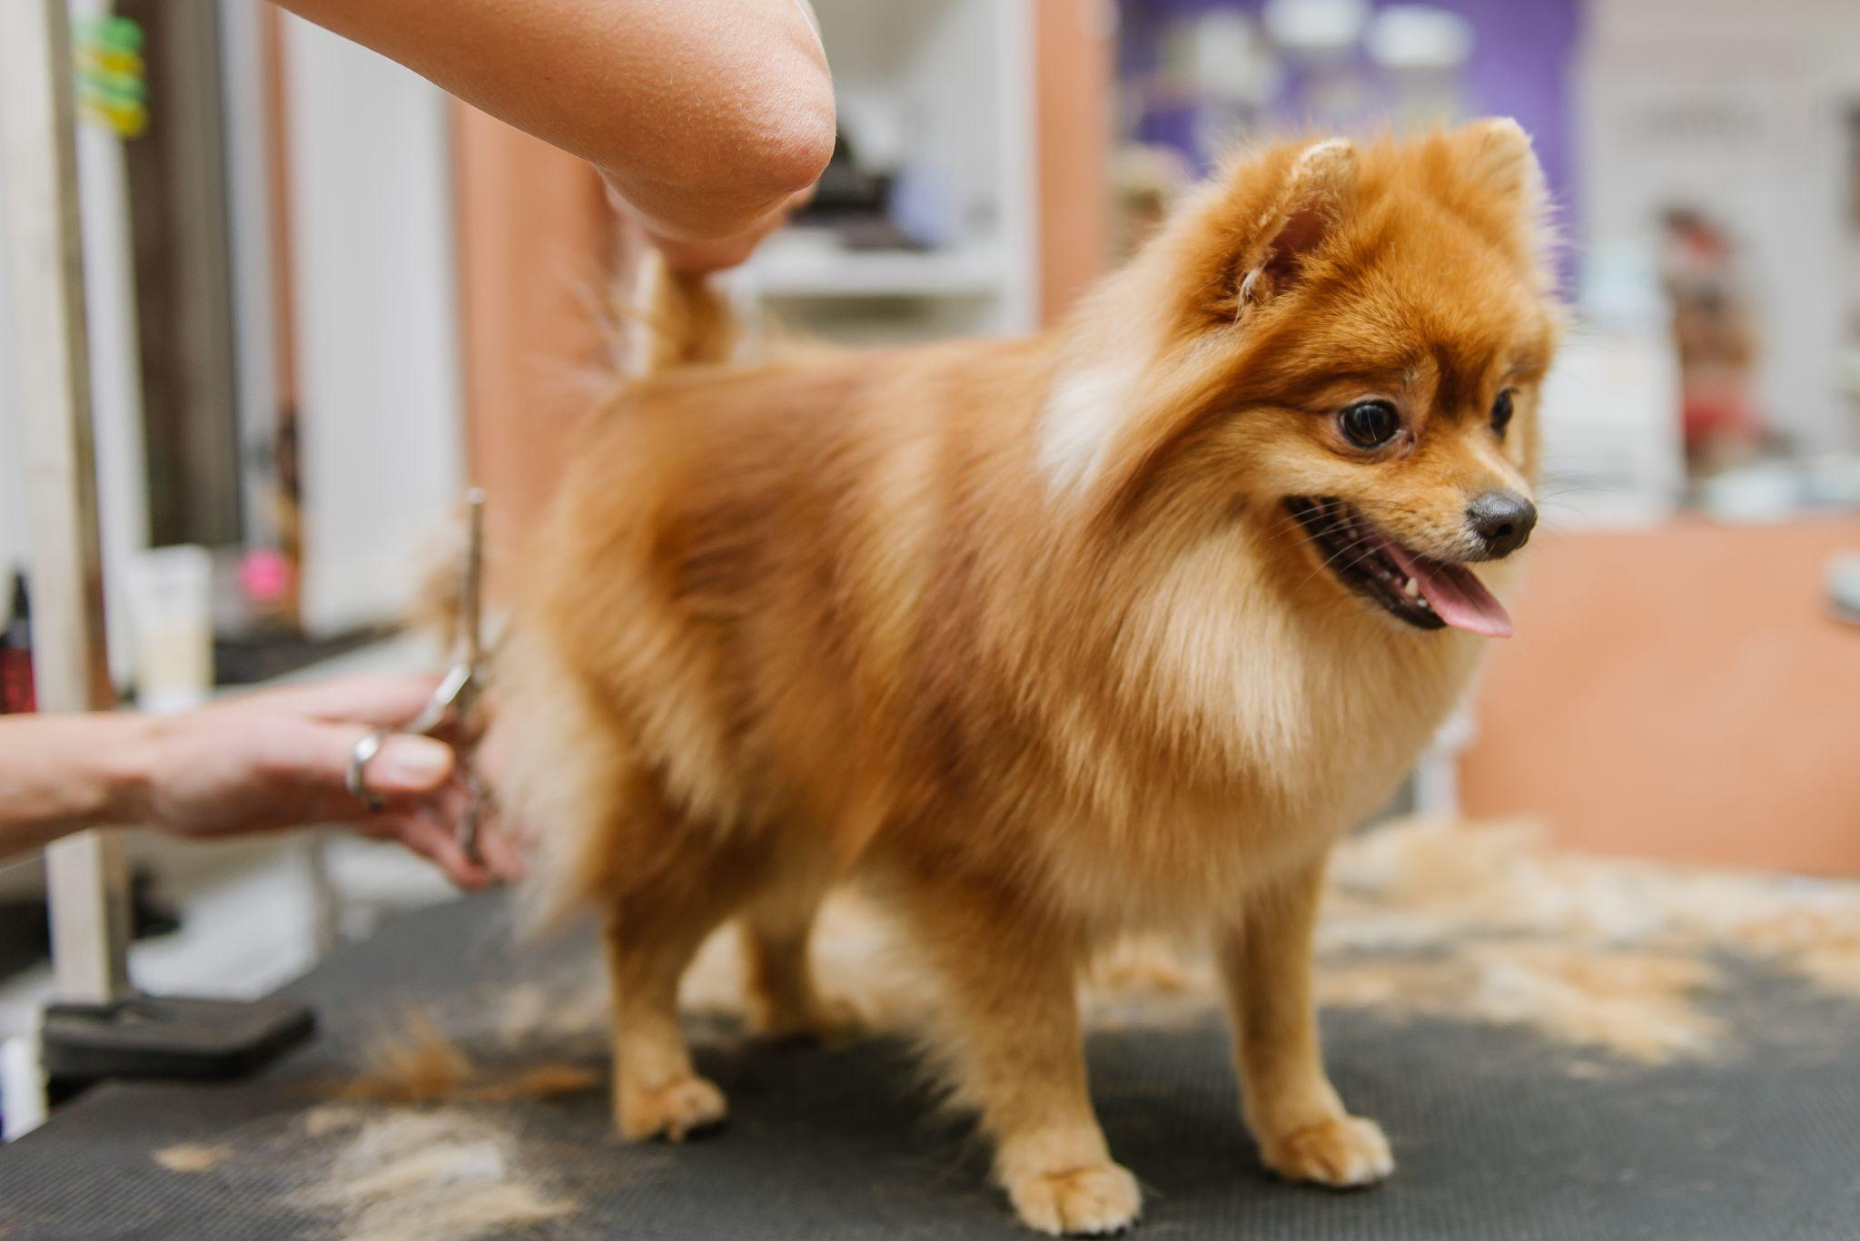

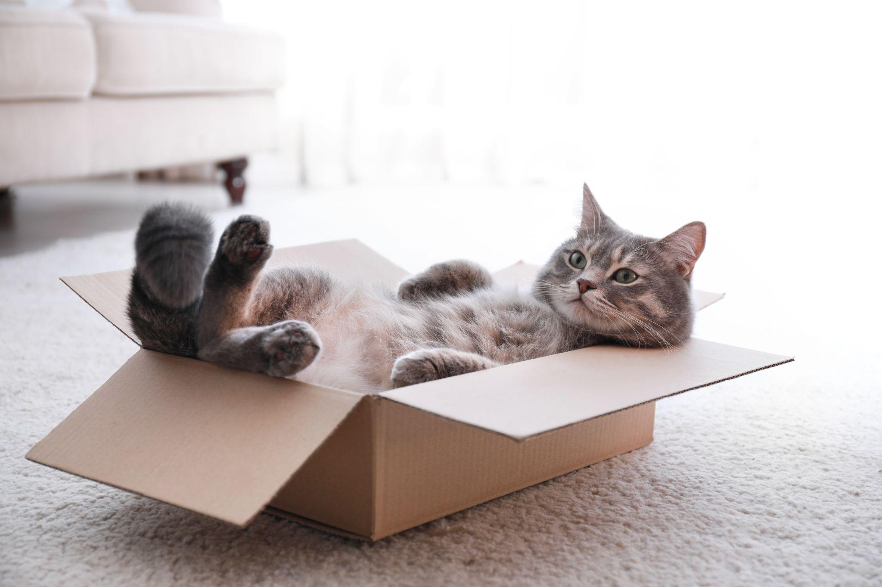
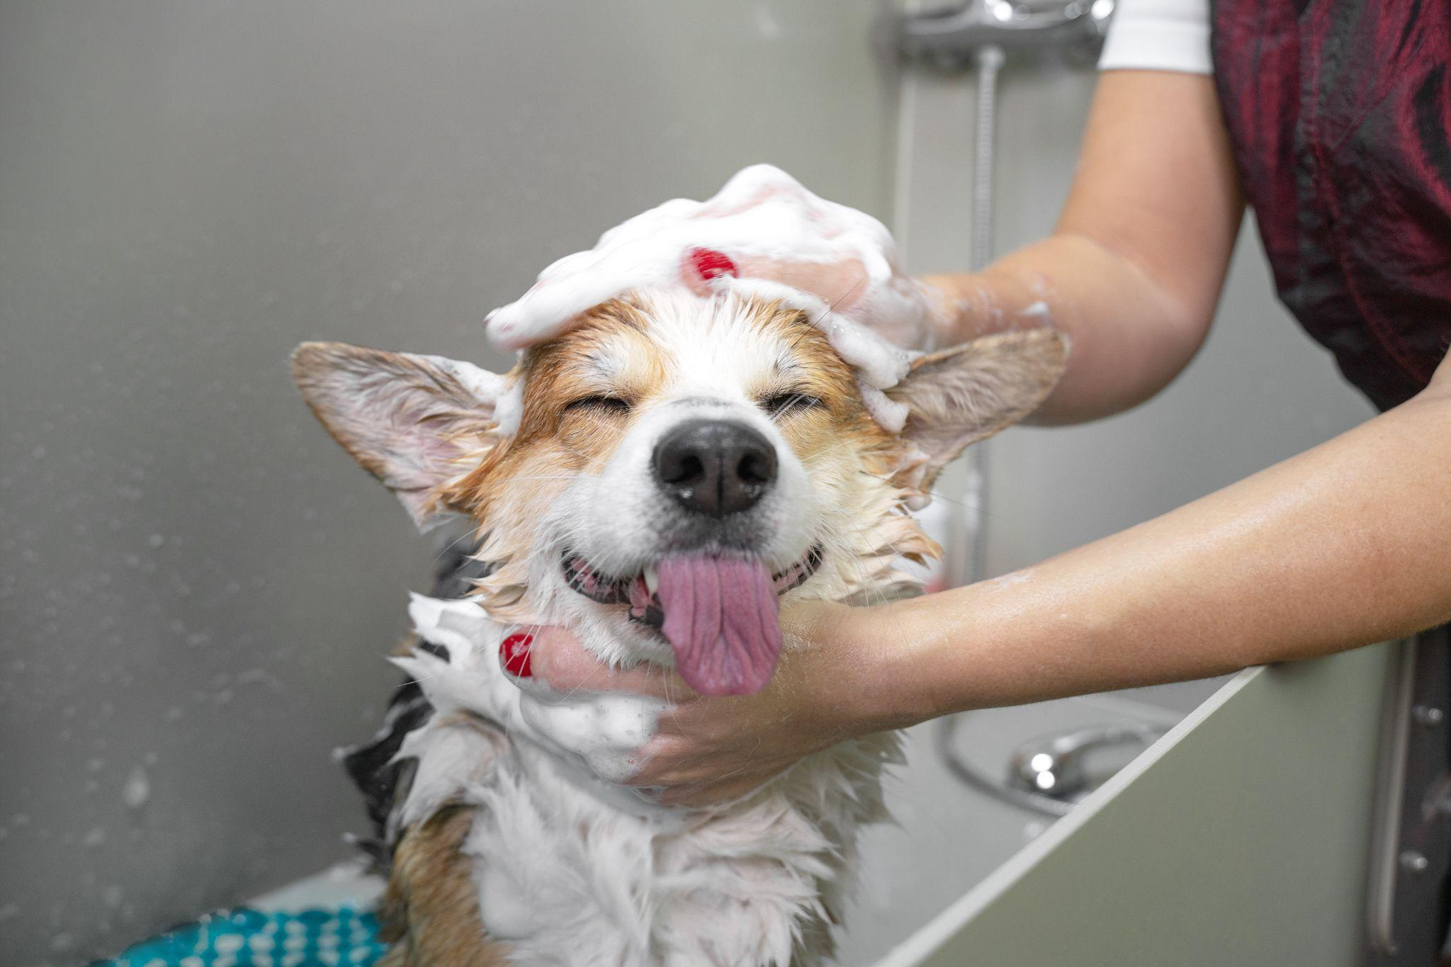

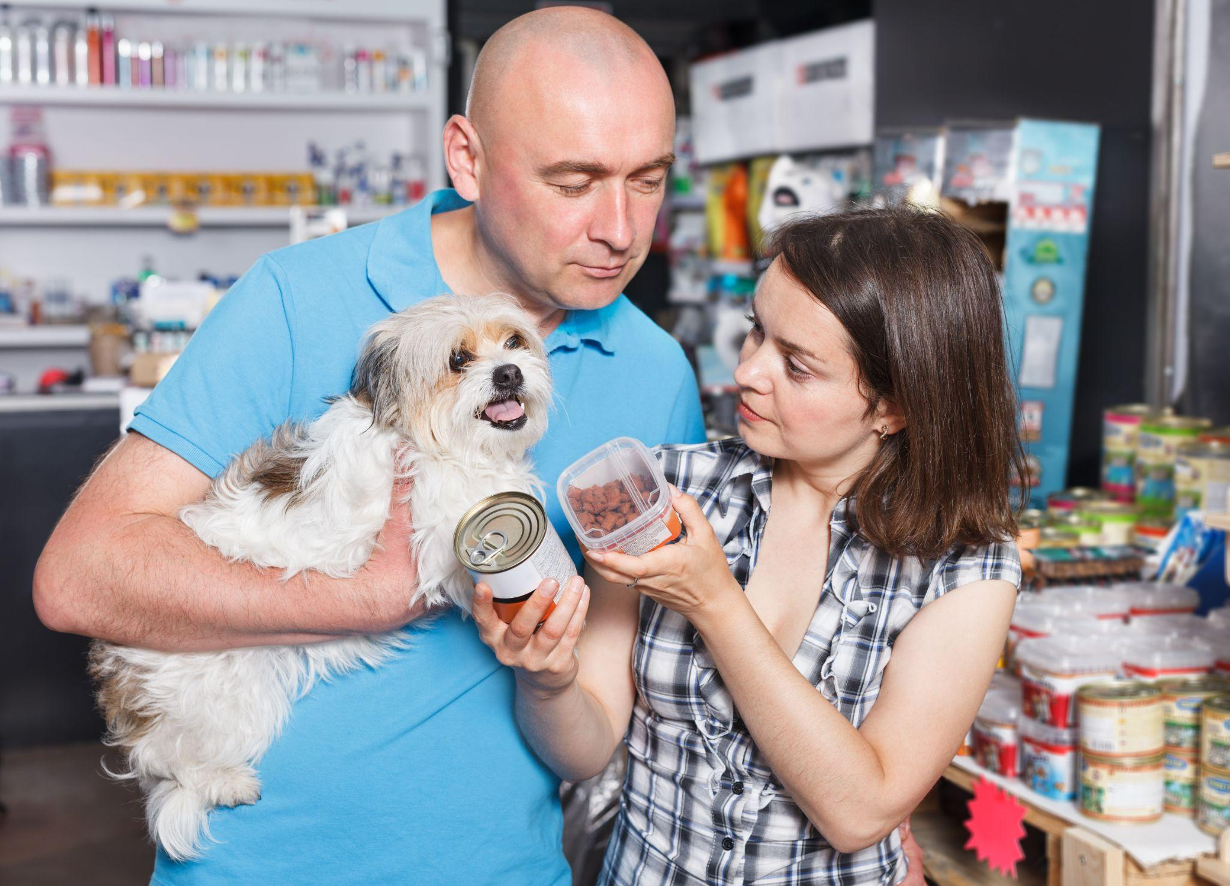
Images from Inu + Neko
Here are a few images that can be used throughout your deck that are part of the Inu + Neko image library.

Slide 3

Course 2 Capstone
The OSEMN Process

Slide 4
Your Approach 1 of 4
Give at least two example questions you would want to answer as an analyst that relates to Inu + Neko’s business problem.
Remember a good question includes a focus on something that is actionable and follows the SMART goal principles (specific, measurable, attainable, relevant, & timely).
1. In the last month, what channel are the new clients from? Internet, physical store, etc. And the old clients?
2. What are the ten products bought more by new clients and old clients in the last month?

Slide 5
Your Approach 2 of 4
What information do you think would be particularly important to your analysis for Inu + Neko?
Sales per month and total sales data.
Acquisition data.
Channel data.
Selling products data.

Slide 6
Your Approach 3 of 4
How would you go about gathering this information?
I would collect data about channel of acquisition in Google Analytics and the data about sales in the system of Inu + Neko.

Slide 7
Your Approach 4 of 4
What are some potential issues or roadblocks can you see in trying to get this information to address Inu + Neko’s business problem?
I don’t see potential problems, but if Inu + Neko don’t have Google Analytics the acquisition of data about channels would be harder and then the analysis would be a problem.

Slide 8
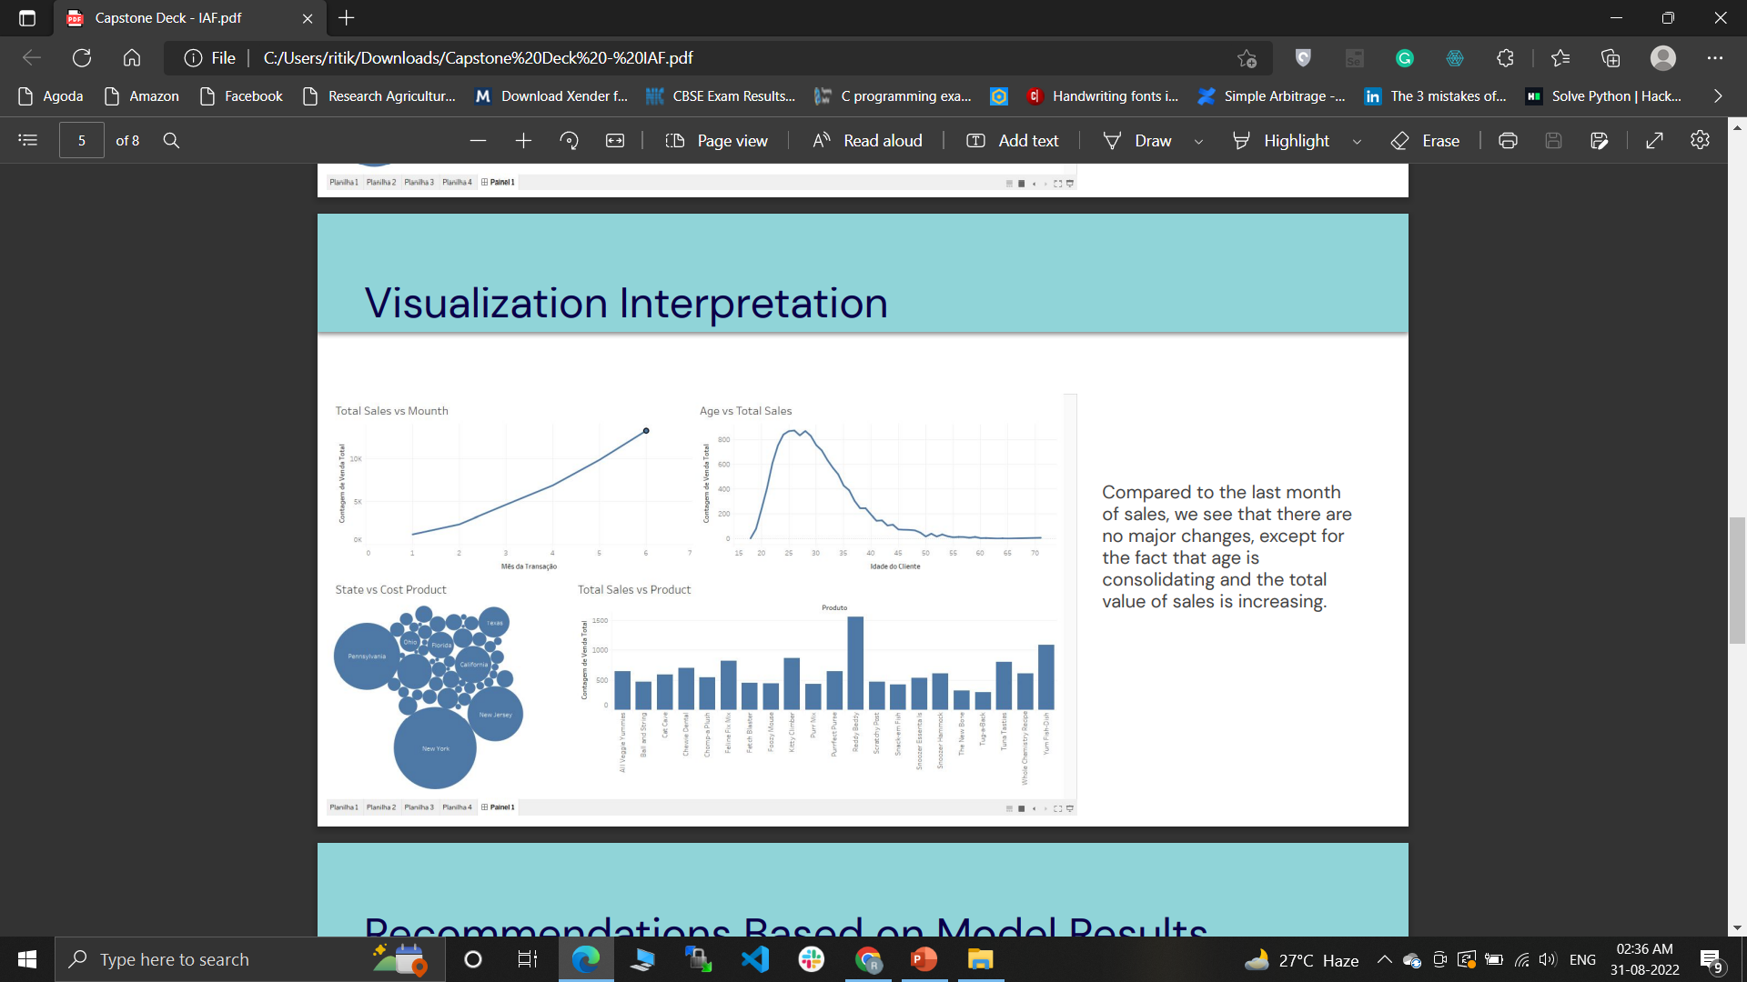
Your Data Visualization
Using Tableau, create the requested visualization (Placeholder). See Step 2 for additional instructions. The CSV is linked here.

Slide 9
Your Visualization Interpretation 1 of 2
What does this visualization show about the data?
In the first month, the main client had 25 years old and them were from New York, Pennsylvania, New Jersey and Texas. The main sold product is the Reddy Beddy

Slide 10
Your Visualization Interpretation 2 of 2
Does this visualization align with what we’ve seen so far from the data?
Enter your answer here:

Slide 11
Recommendations Based on Model Results 1 of 2
What recommendations would you give Inu + Neko based on the model results?
The model predicts that there will be new customers but likely not the same growth rate they saw from the prior 6 months.
Inu + Neko can work with the loyalty of new customers, for example by making a loyalty program where every 5 purchases they will get a discount or a free product.
A second action could be a campaign focused on users between 25-30 years old and residents of New York, Pennsylvania, New Jersey and Texas, offering free shipping or discounts on their first purchase.

Slide 12
Recommendations Based on Model Results 2 of 2
What recommendations would you give Inu + Neko based on the model results?
Compared to the last month of sales, we see that there are no major changes, except for the fact that age is consolidating and the total value of sales is increasing

Slide 13
Your Final Insights 1 of 4
What can you say about the current state of the business?
The business currently shows steady growth, going from 1.2k sales in the first month to 13.2K in the last month.

Slide 14
Your Final Insights 2 of 4
What projections can you make about the future state of the business?
The business will continue to grow steadily, perhaps not as expressively as it is now, but by consolidating the target audience, the tendency is for sales to grow, especially in New York, Pennsylvania, New Jersey and Texas

Slide 15
Your Final Insights 3 of 4
What would you recommend to Inu + Neko?
I would recommend the company to work on marketing campaigns targeting users who are between 25-30 years old and residents of New York, Pennsylvania, New Jersey and Texas

Slide 16
Your Final Insights 4 of 4
What more work could be done to expand on your analysis?
(You won’t need to do this but state what would be good next steps for a follow-up analysis.)
1.Top 10 best selling products
2. Top 10 least sold products
3. Top 3 product city
4. Average ticket study

